Slide 1
Model Predictive Control
Project 3

Slide 2

Competitive Tag

Slide 3
Self-Driving Car

Slide 4
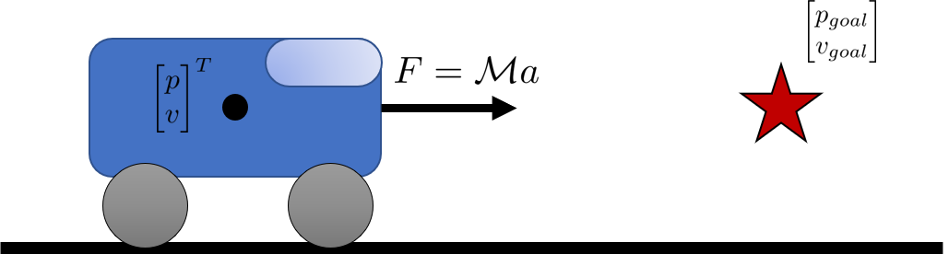
Simplified Version: Car on a Straight Path
p: position
v: velocity
x: state of the car = [p; v]

Slide 5
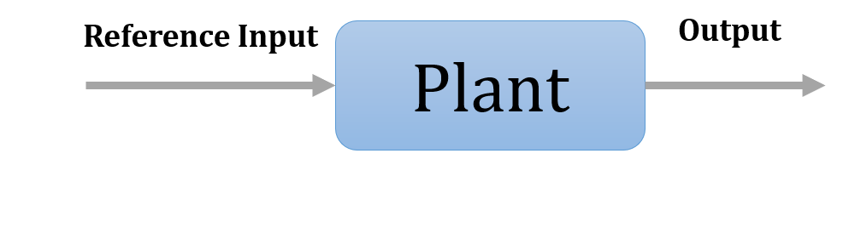
Open-Loop Control (Blindfolded)

Slide 6
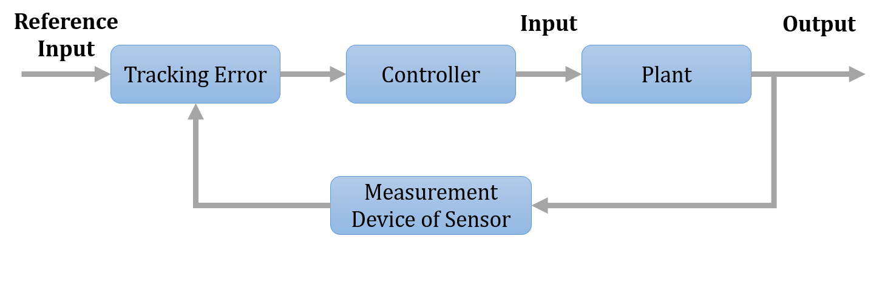
Closed-Loop Control (Eyes Wide Open)

Slide 7
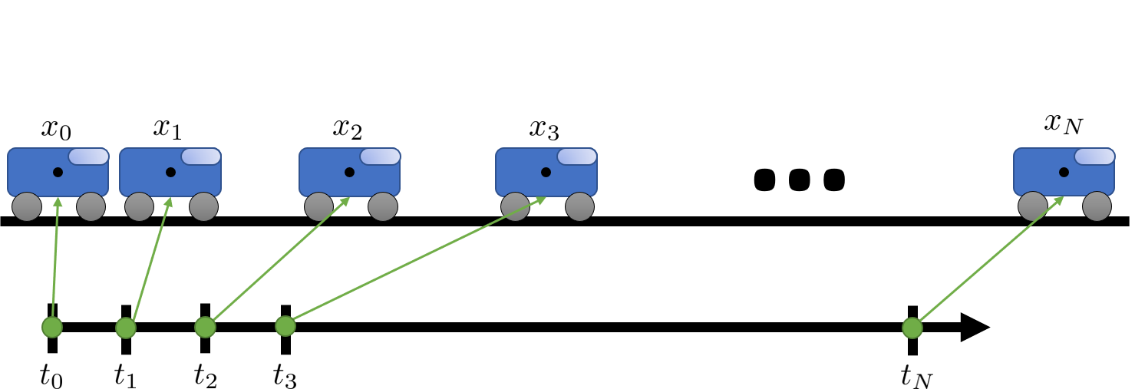
Car Trajectory

Slide 8
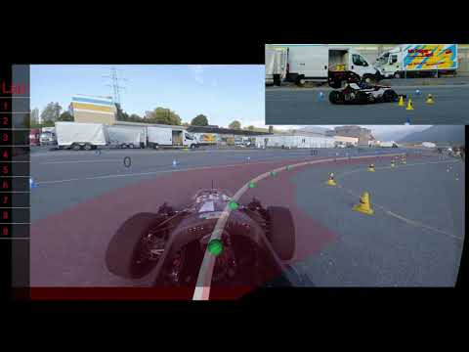
Real-World Example!
Start – 1:20
End – 1:45
Loop

Slide 9
Project 3: Segway

Slide 10
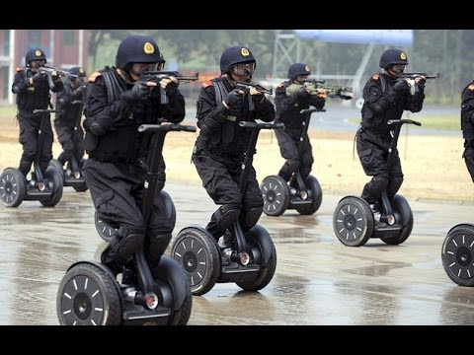
Segways!

Slide 11
